Slide 1

Smart Campus Early-Warning & Decision Support System
Team Members: Kavyalakshmi | Baby Jyostna | Charan | Tharun

Slide 2
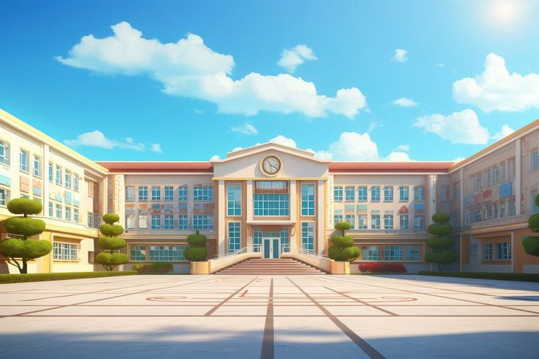
Objective
The main objective of this project is to monitor different campus conditions and identify potential risks at an early stage. The system uses campus data and Machine Learning to predict the risk level and provide an early warning along with a recommended preventive action.

Slide 3

Main Features:
Risk Prediction – Analyze the input data using a Machine Learning model.
Risk Classification – Classify the situation into:
1.Low Risk
2.Medium Risk
3.High Risk
Early Warning – Generate a warning when a potential problem is detected.
Recommended Action – Suggest preventive action for the detected risk.
Simple Dashboard – Display input values, risk level, warning, and recommendation clearly.
Real-Time Analysis – Analyze the values entered by the user and immediately show the prediction.

Slide 4

Technologies Required:
Technologies
Purpose
Programming
DataManipulation
Computation
Plotting
Visualization
MachineLearning
Classification/Prediction
Serialization
Deployment
Storage
Python
Pandas
NumPy
Matplotlib
Seaborn
Scikit-learn
Random Forest
Joblib
Streamlit
CSV

Slide 5

Modules
01
Data Input Module
02
Data Processing Module
03
Machine Learning Prediction Module
04
Risk Classification Module
05
Early Warning Module
06
Recommendation Module
07
Dashboard/Output Module

Slide 6

Dataset Requirements
smart_campus_early_warning_dataset.csv
It should contain the following columns:
- Temperature
- Humidity
- Rainfall
- Water Level
- Electricity Usage
- Occupancy Rate
- Attendance Rate
- Internet Usage
- Maintenance Complaints
- Previous Incidents
- Air Quality Index
- Risk Level
The Risk Level column can be used as the target/output for Machine Learning.

Slide 7
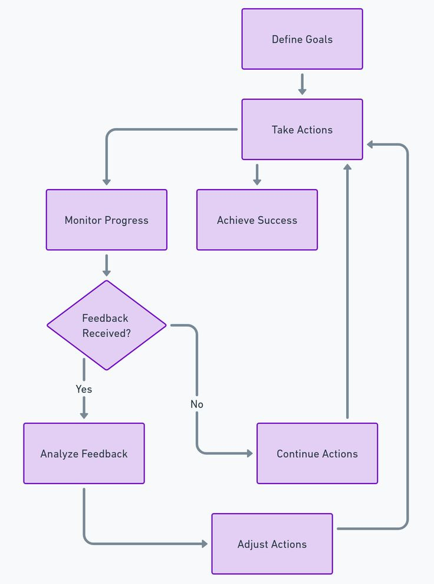
Processing Flow
Campus Data Input
⬇
Data Preprocessing
⬇
Machine Learning Model
Risk Prediction
⬇
Risk Classification
⬇
Early Warning Generation
⬇
Recommended Action
⬇
Dashboard Output

Slide 8

💡 Benefits
Early identification of potential risks.
Data-driven decision-making.
Helps management prioritize interventions.
Combines student, campus, and environmental information.
Provides visual insights through charts.
Can be extended to real-time campus monitoring.

Slide 9

Final Goal
The main goal of this project is to help campus management identify potential problems before they become serious. Instead of waiting for an incident to occur, the system analyzes campus data, predicts the risk level, generates an early warning, and recommends preventive action.

Slide 10
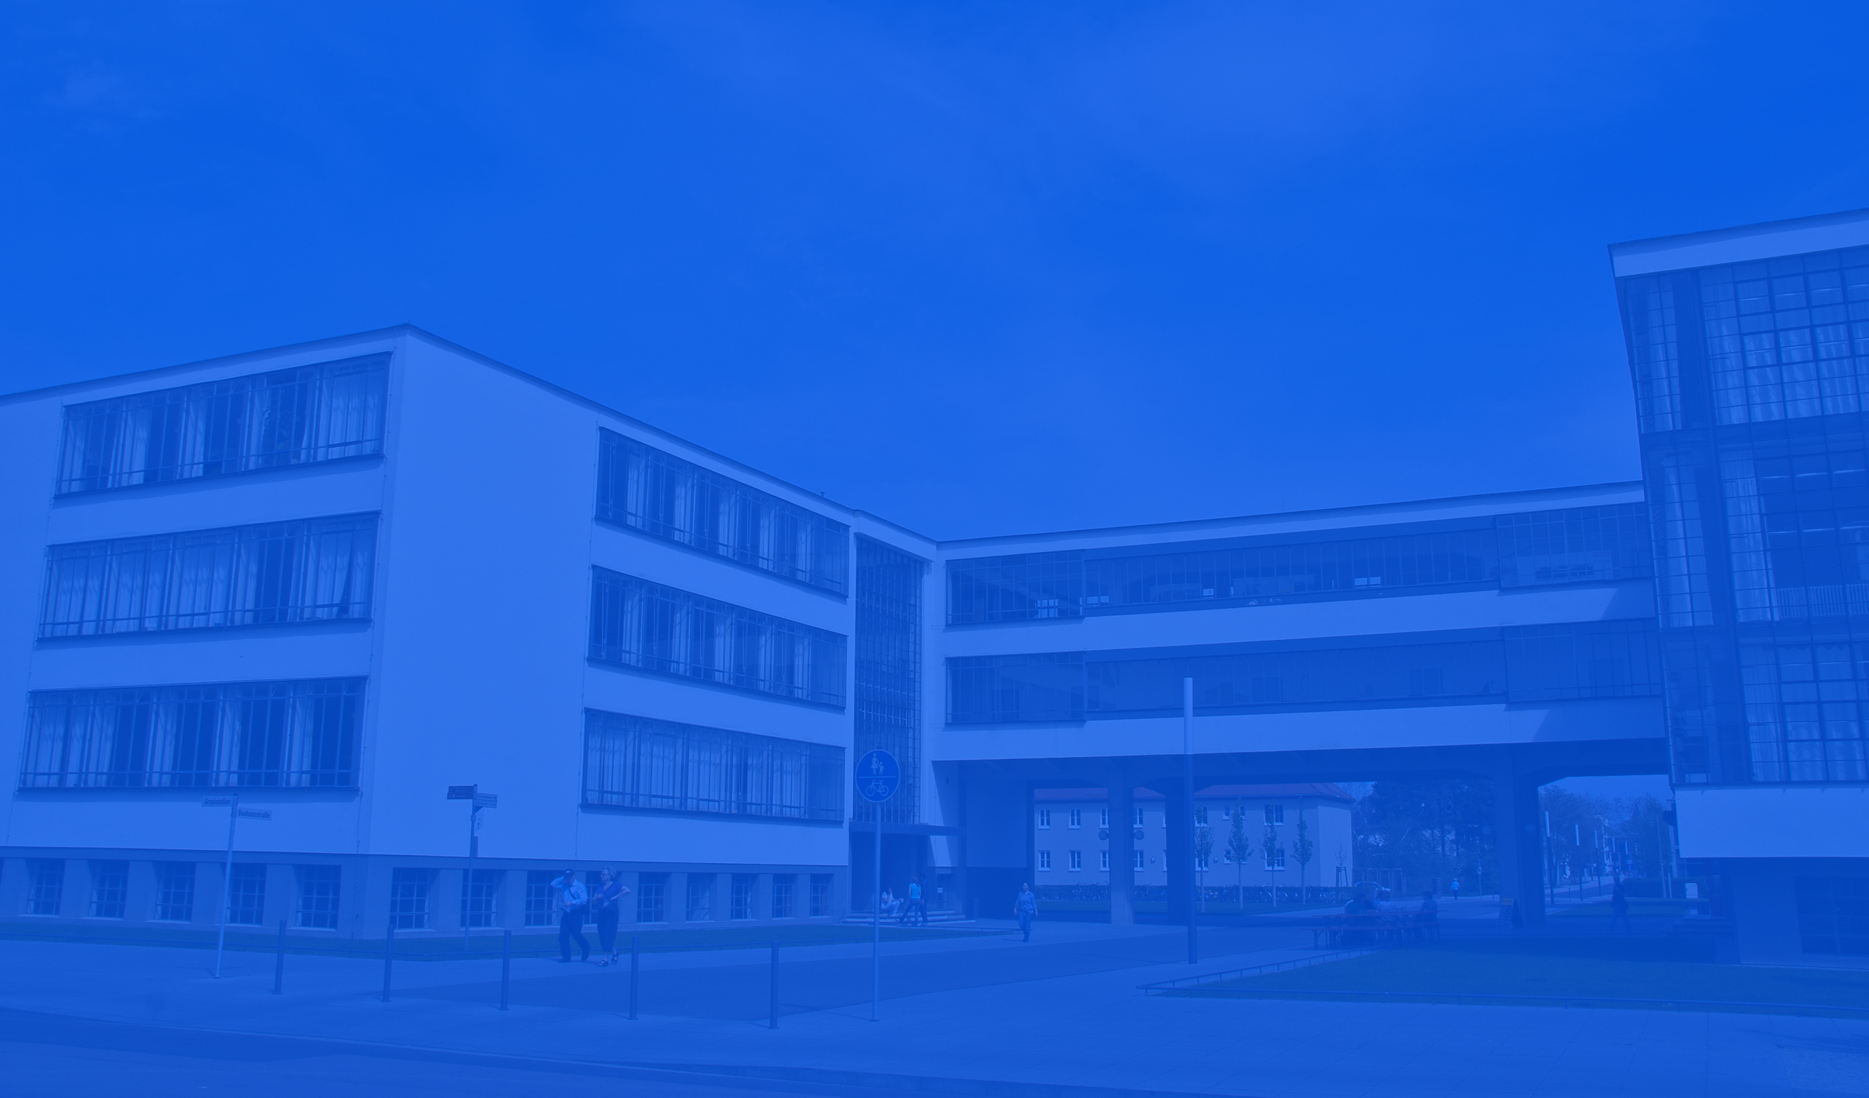
Thank You

